Slide 1


Artificial Intelligence & Convergence of Ideas
17 Oct 2023
Nikan Doosti

Slide 2
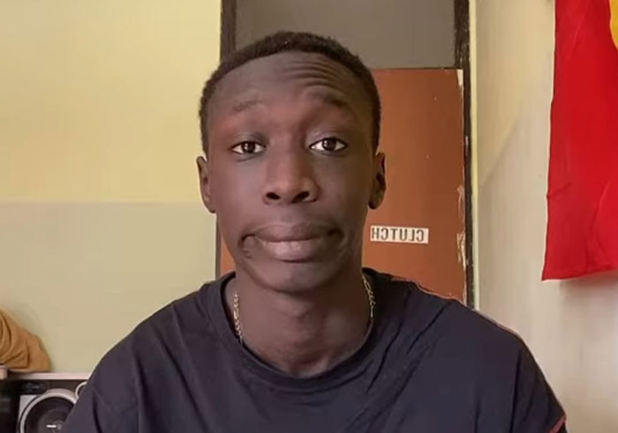
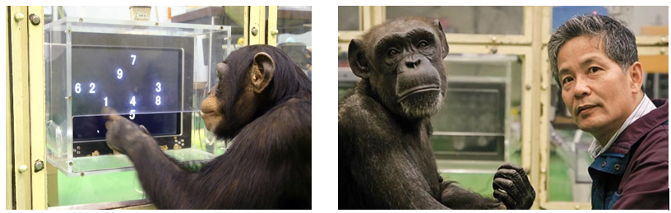
What is AI?
The study of intelligence is over 2000 years old (philosophers)
We don’t know really!
Artificial
Intelligence
keepmeme.com
The ability to learn and perform techniques
Solve problems and achieve goals
In an uncertain, ever-varying world
Man-made
Synthetic
Example
Images courtesy of blogs.cornell.edu

Slide 3
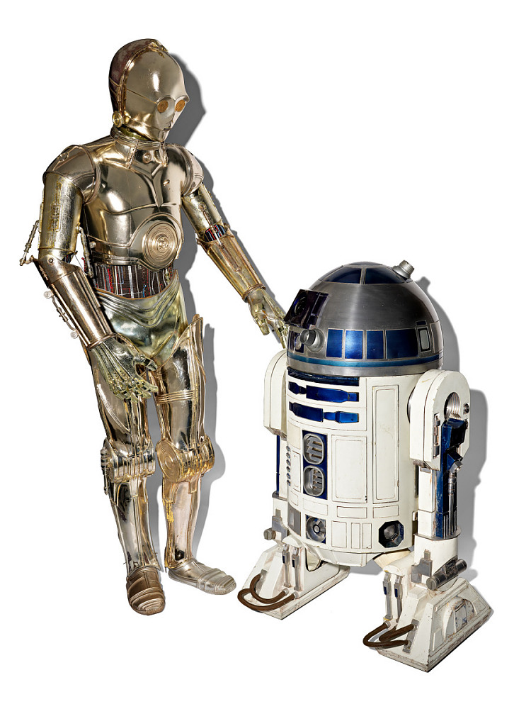
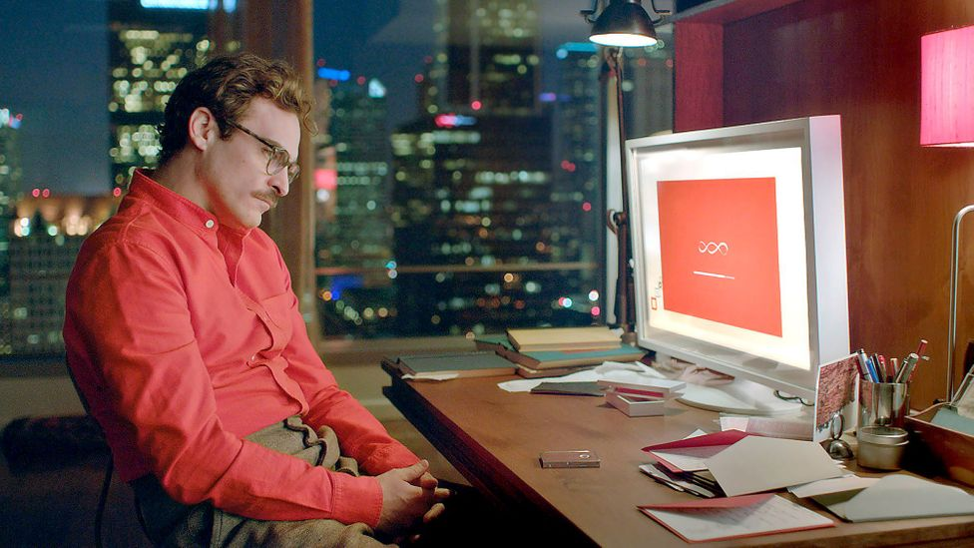
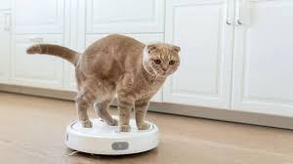
What is AI?
Artificial Intelligence
The ability to learn and perform techniques
Solve problems and achieve goals
In an uncertain, ever-varying world
Her (movie)
Vacuum Cleaner
3PO & R2D2
not ME!
bbc.com
depositphotos.com
Walt Disney Company
Notes:
Compare “humanly” behavior (thinking) and humanly acting

Slide 4
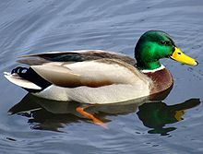
What is AI?
Duck Testing
it probably is a
Artificial Intelligence
If it:
Looks like a duck
Swims like a duck
Quacks like a duck
reasoning
Her (movie)
Vacuum Cleaner
3PO & R2D2
not ME!
bbc.com
depositphotos.com
Walt Disney Company
Notes:
People go for duck testing because they are looking for specific traits and behavior rather than underlying systematic analysis (e.g., turing test which is not necessarily the best)

Slide 5
What is AI?
Duck Testing
it probably is a
Artificial Intelligence
If it:
Looks like a duck
Swims like a duck
Quacks like a duck
reasoning
Artificial Intelligence
Categories*
Acting humanly
Acting rationally
* For simplicity, the two other categories have been eliminated.
Notes:
Acting humanly: Turing Test
Rational behavior = doing the right thing (humans get mad an do some stuff sometimes that are not in their best interest;) rational system maximizes reward.

Slide 6
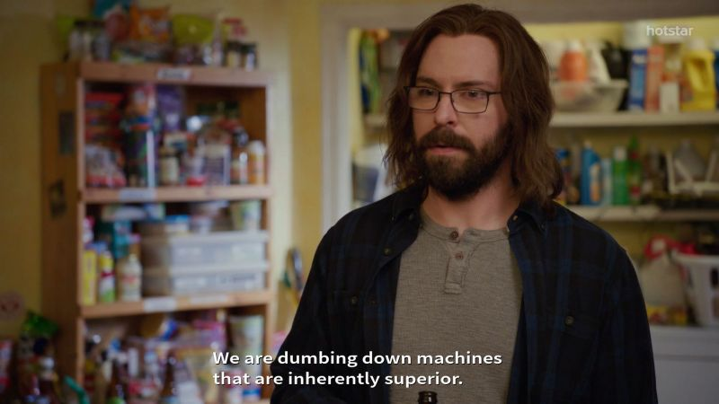

What is AI?
Turing Test
Dev Rant
Wikipedia
Notes:
Acting humanly: Turing Test
Rational behavior = doing the right thing (humans get mad an do some stuff sometimes that are not in their best interest;) rational system maximizes reward.

Slide 7
The “thingy” | Old Era | New Era | “Near” Future
Vacuum Cleaner
Her
3PO & R2D2

Slide 8
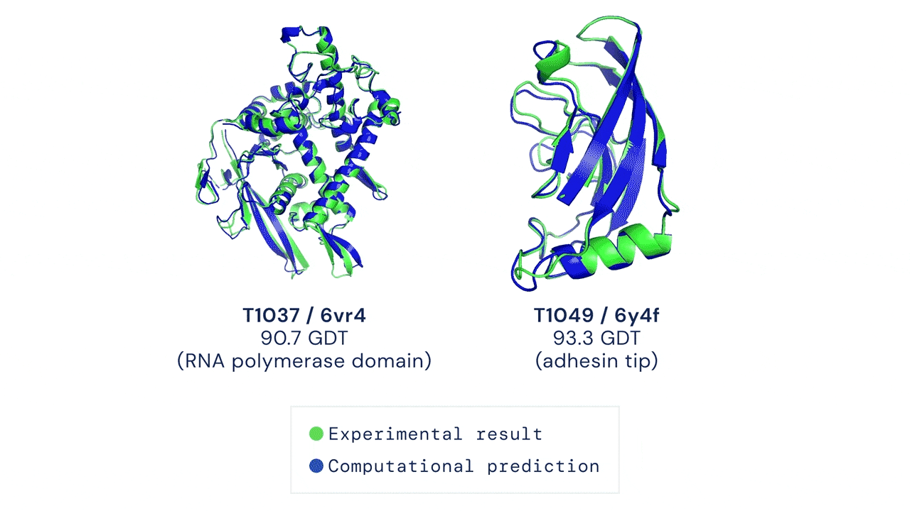
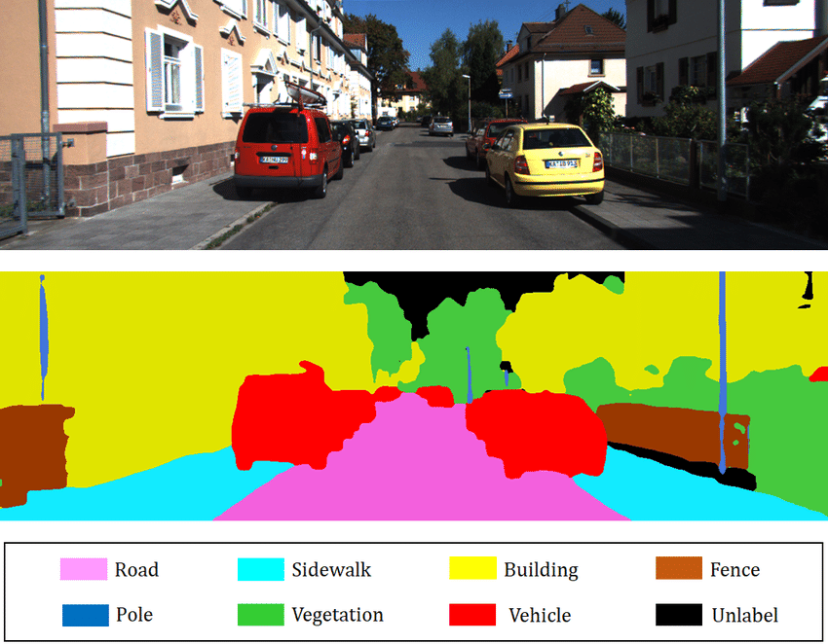
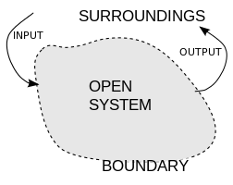
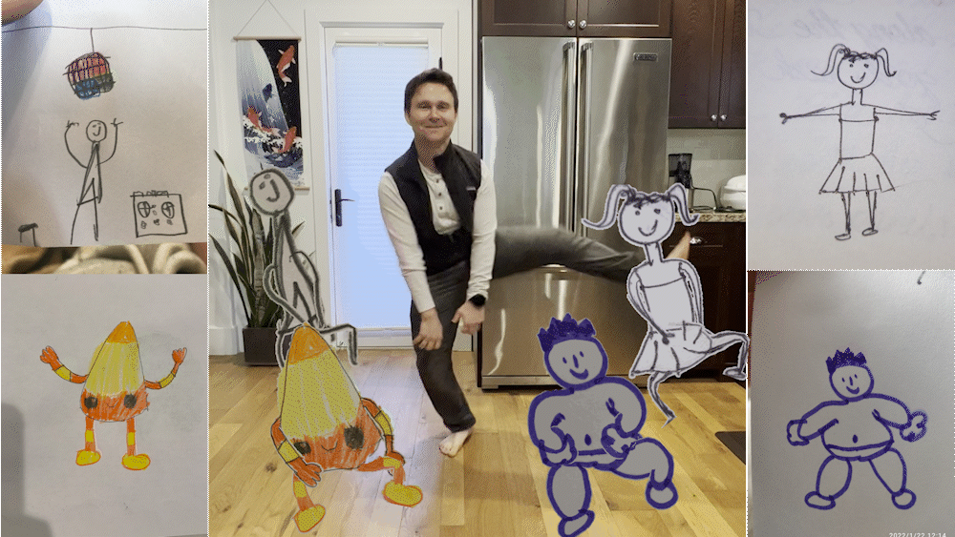
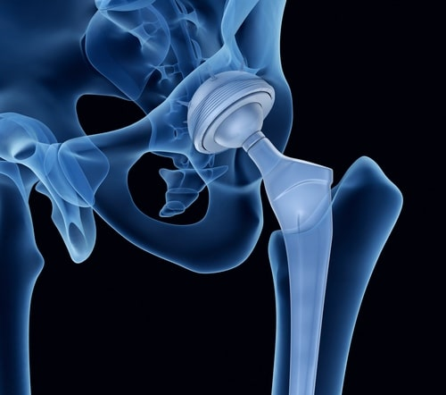
AI is a system
like everything else!
Science
Technology
Smart
Google DeepMind
Education
Healthcare
wikipedia.com
TU Delft
Meta Research
Notes:
Alphafold: the 50 years old problem. predicting the shape of the protein, which defines it functions-> understanding diseases, designing new drugs
Health Care: Hip Dysplasia . Patient specific low cost design with about 5-10 more years of life دررفتگی مفصل ران
Tech, self driving car:
I hated drawings, meta made me to draw to just see how it would dance

Slide 9
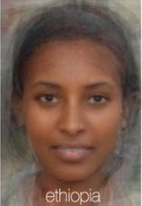
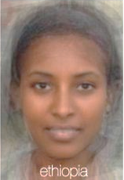
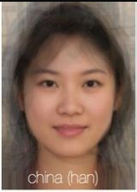
The bad side?
Bias
Privacy
Ownership
Job Replacement
Xiaomi AI Camera
An Ethiopian woman
An Ethiopian woman with a lighter skin*
Why?
Average face of Chinese woman
Images courtesy of Daily Mail
*For demonstration purposes, the lightness have been intensified manually.

Slide 10
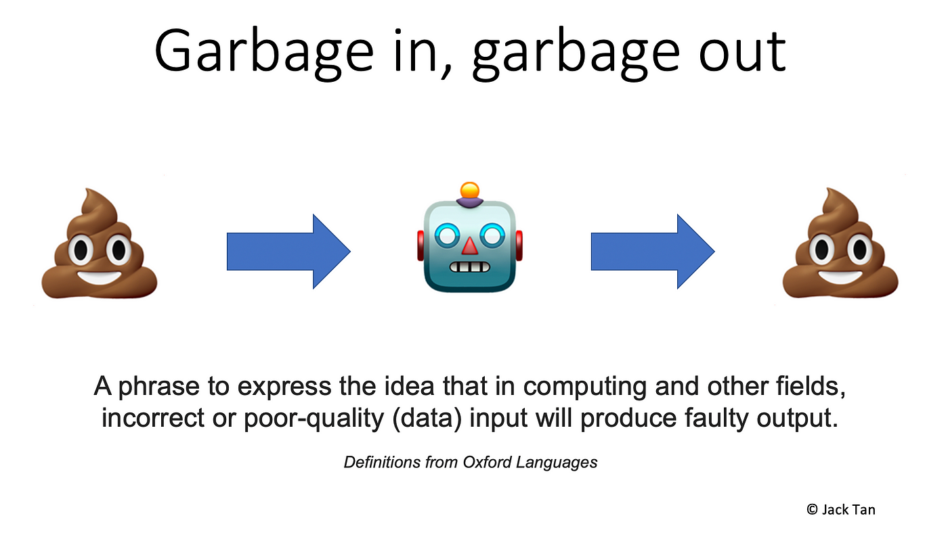

Slide 11
We humans are biased too:
The most common cognitive bias (By Veritasium):
Mine:
2, 4, 8, 16
Yours:
????
What is the rule?
Notes:
You came up with idea that matches the sequence, and only started to propose things that fit what you THOUGHT FIRST and OBSERVED.

Slide 12

For “people” AI is:
Just another “tool” to be (ab)used
AI is like the cream in a cake

Slide 13
AI is:
[machines] just smart enough to run the [tasks] and just dumb enough to passively accept their situation
AI is not dangerous, but the person who uses it can be
The quote is adopted with slight modification from George Carlin Stand-up Special

Slide 14
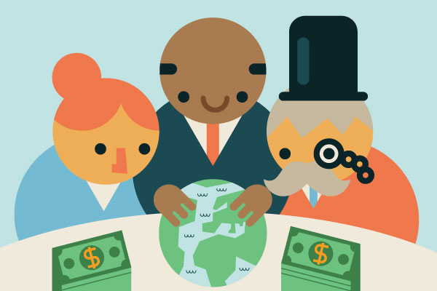
Oligopoly
An oligopoly is a market in which:
Control over an industry lies in the hands of a few large sellers
They own a dominant share of the market
Notes:
Def: A market in which a few large firms dominate. Barriers prevent entry to the market, and there are few close substitutes for the product.
Opposed to: Perfect competition. A market in which there are many buyers and many sellers of an identical product.
Iran is entirely run in cartel mode which is practically similar. Cartel is: a group of independent companies which join together to fix prices, to limit production or to share markets or customers between them

Slide 15

Micro$oft
How would you feel if:
All the food in the shops were provided by one manufacturer without any healthier alternative?
You moved to another city/country and still the same company is there
The textbook chapters have been written by the marketing department of the very same company
Tenor

Slide 16
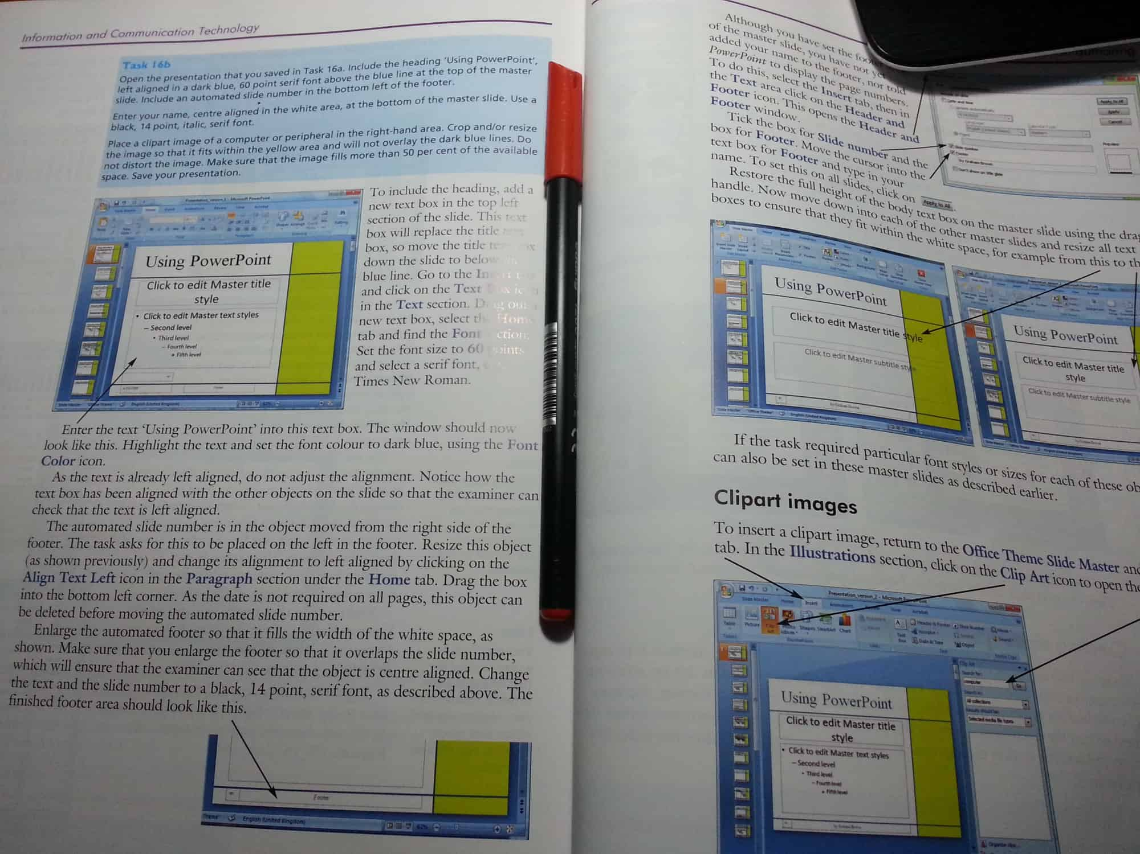
Micro$oft
Students are taught Microsoft Word,
Students are taught Microsoft PowerPoint,
not word processing
not presentation skills
This entire page is based on Paul Brown’s “mining for education”.
Notes:
They are required to present their work, be it essay, slideshow, or graph, in Microsoft-owned proprietary formats, recorded onto thumb-drives formatted with a Microsoft-patented file systems. Nothing else will do.

Slide 17
Micro$oft
Students are not taught word processing, they are taught Microsoft Word
They are not taught presentation skills, they are taught Microsoft PowerPoint
Wide spread adoption
The financial benefit itself
Shaping dependent people exclusively on MS “services”
They define the standard (you must follow)
Features
“premium” edition
WHY?
“standard” edition
User standard
Time
This entire page is based on Paul Brown’s “mining for education”.
Notes:
For a mega-corporation like Microsoft this makes perfect sense. Not only is the education market immense and juicy in itself, but the prospect of shaping students into future workers, managers, and entrepreneurs that have literally and formally learnt to depend exclusively on their products must be irresistible.

Slide 18
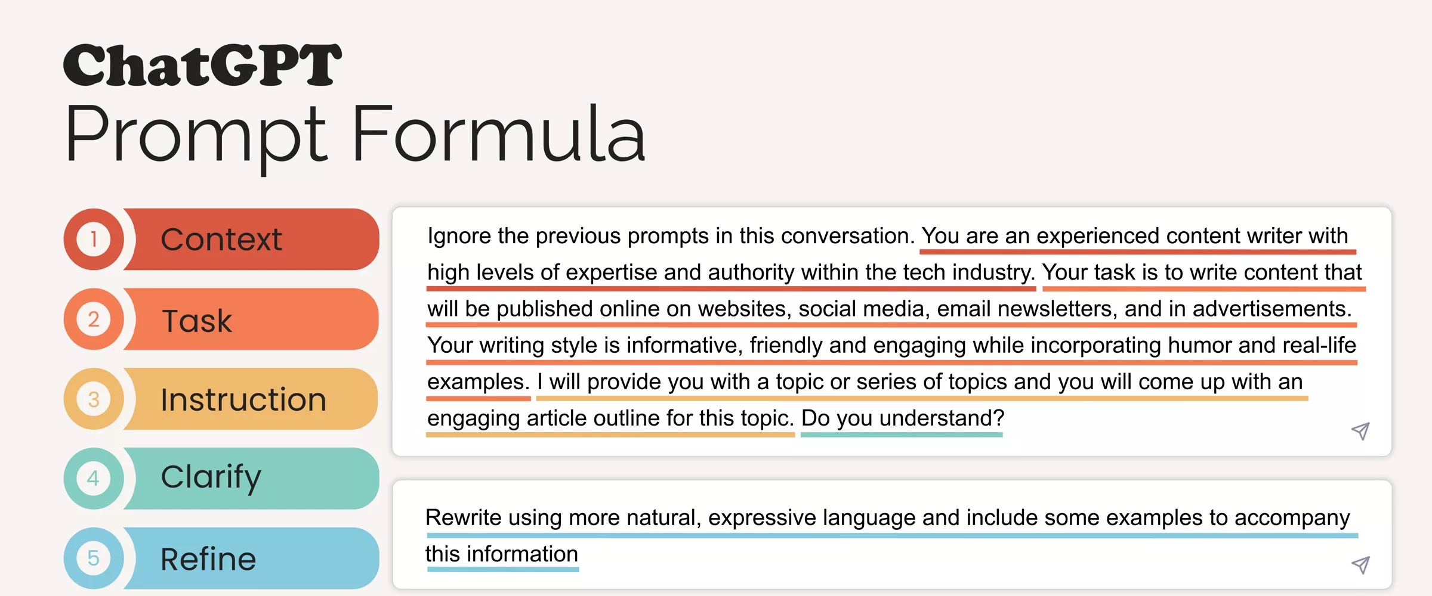
OpenAI’s ChatGPT

Slide 19
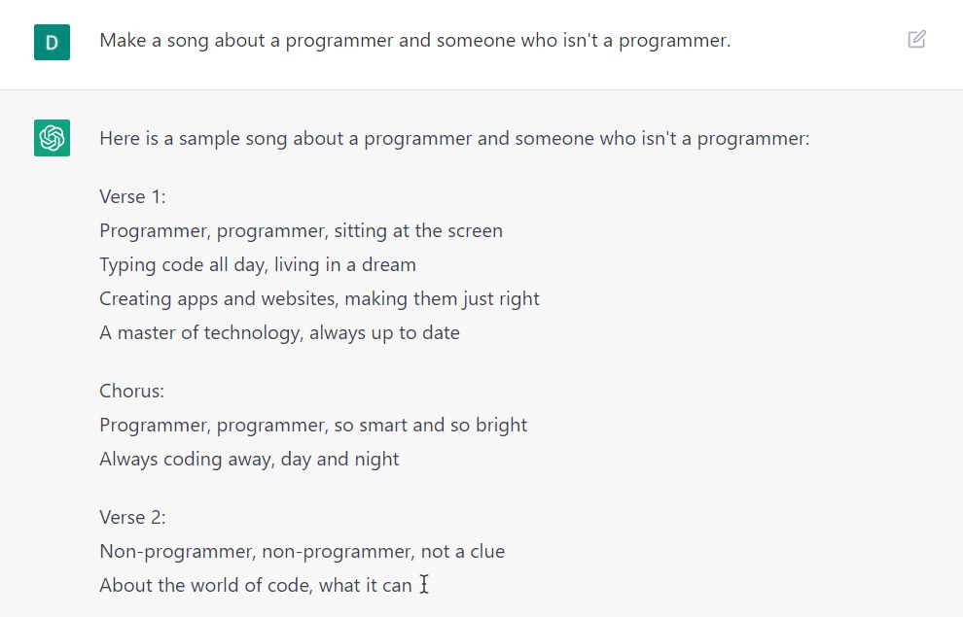
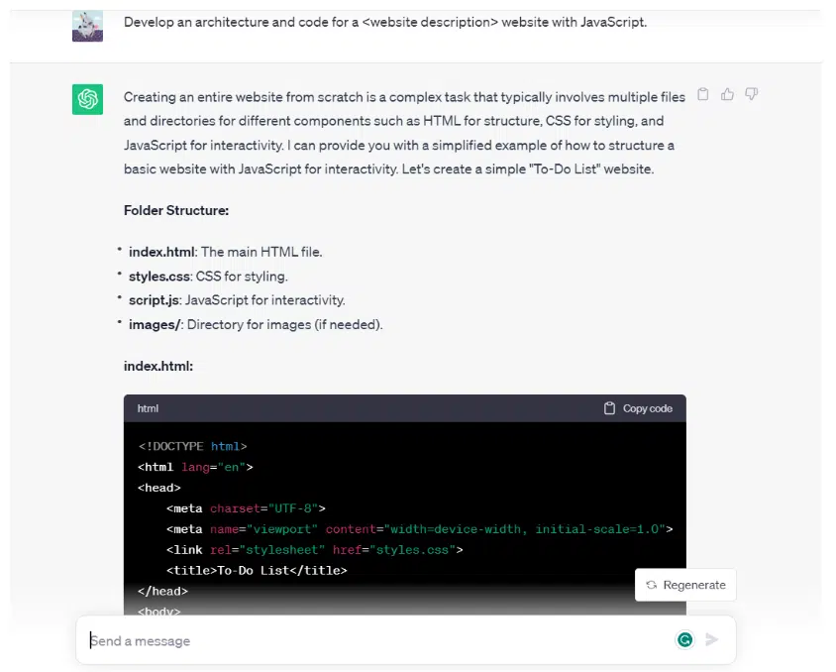
OpenAI’s ChatGPT

Slide 20
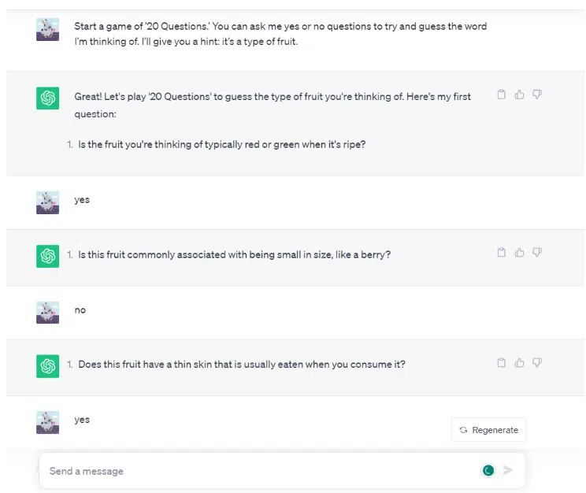
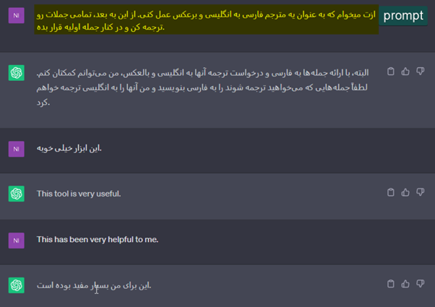
OpenAI’s ChatGPT

Slide 21
OpenAI’s ChatGPT
Now:
Users
Google
Read
Verify
Result
How people can get to the answers:
AI
Future:
Users
Google
Read
Verify
Result

Slide 22
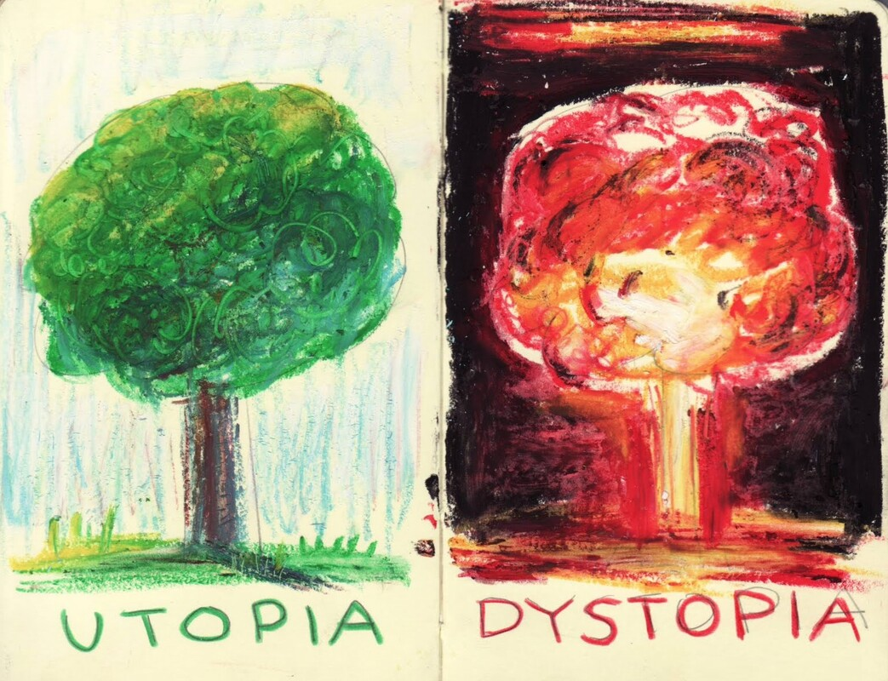
Brave New World
Dystopian science-fiction novel
set in a futuristic London society in the year 2540 AD (published 1931)
About technology, politics, and consumer culture
ideology-theory-practice.org
Everyone is “happy”
The world’s stable now. People are happy; they get what they want, and they never want what they can’t get.
Technological Advancement
Oppression
(Orwell’s 1984)
Standards
i.e., guardrails
Adopted from Four Minute Books
Notes:
Huxley imagined a world in which technological progress would not lead to mass surveillance, mind control, and oppression, like it does in George Orwell’s 1984. Instead, he painted a future in which “everyone is happy now,” mostly thanks to drugs and frequent, non-committal sex. People are produced in factories, grouped into social classes, and conditioned to love their existence — and spend as much money as they can.

Slide 23
Micro$oft AI
Students are not taught word processing, they are taught Microsoft Word
They are not taught presentation skills, they are taught Microsoft PowerPoint
MS Knowledge, instead of The Knowledge

Slide 24
Thank You

